Slide 1


Real-Time Face and Emotion Recognition
Leveraging Deep Learning and OpenCV for Enhanced Accuracy
Venkata Naidu Gorijala Ronith Juluri Indrani Chuppala Tharun Nayak Bhukya

Slide 2
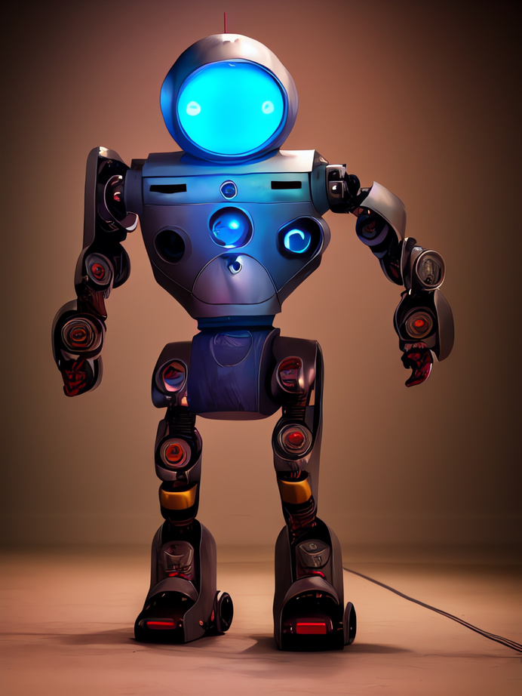
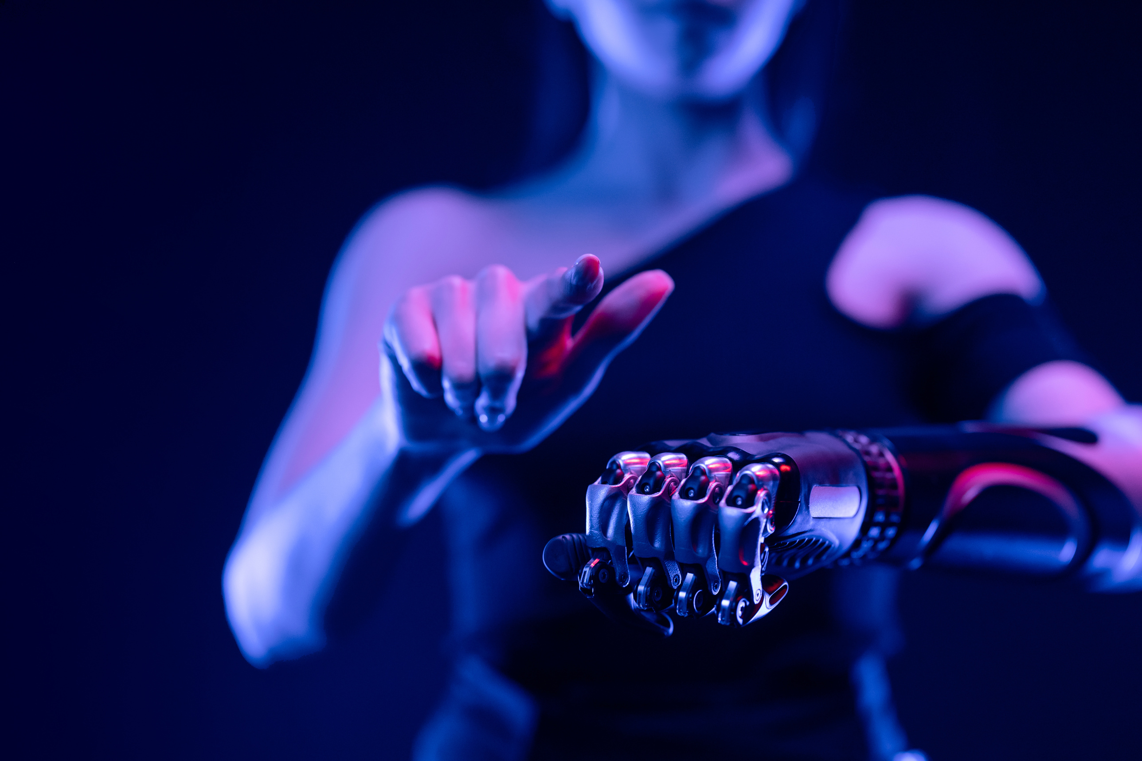

Project Overview
Goal: Build a real-time system for face and emotion recognition using advanced machine learning techniques.
Data collection
Data processing
Model building
Model training and performance
Real-time applications
Challenges and insights
Achievements and future work

Slide 3


Dataset
Face Dataset:
Custom dataset collected using a webcam for 400 grayscale images per person.
Emotion Dataset:
Used a publicly available dataset with 7 emotion classes have 35,000 images: Angry, Disgust, Fear, Happy, Neutral, Sad, and Surprise.
Training set: 28,821 images across 7 classes.
Testing set: 7,066 images across 7 classes.
Data Split:
Both datasets were split into 80% for training and 20% for testing.

Slide 4
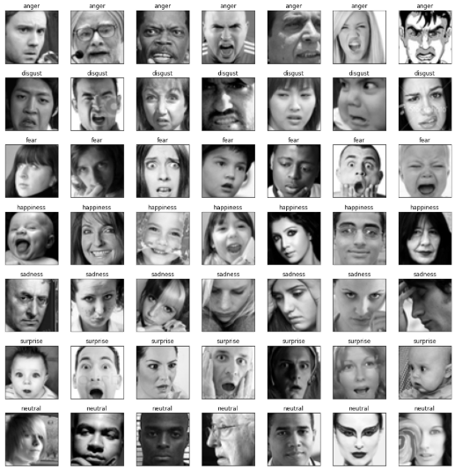
Emotion Dataset:

Slide 5
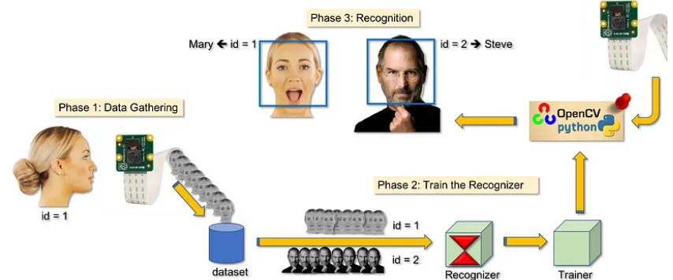
Data Preprocessing for Facial Recognition
Face Detection
Grayscale Conversion
Resizing
Normalization

Slide 6
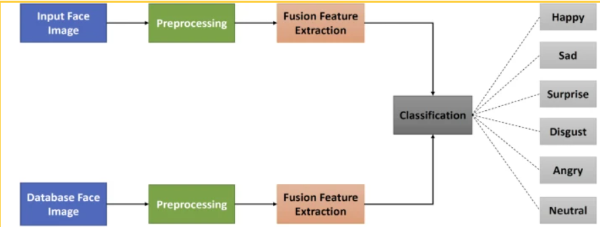
Data Preprocessing for Emotion Detection​
Emotion Detection
Grayscale Conversion
Resizing
Normalization
Class Label Encoding

Slide 7
Facial Recognition – CNN
Input Layer:
Grayscale images of 100x100 pixels serve as input.
2.Feature Extraction:
Convolutional Layers apply filters to extract distinctive facial features, such as the shape of eyes, nose, and mouth.
ReLU Activation introduces non-linearity to capture complex patterns.
MaxPooling reduces spatial dimensions, retaining only the most critical features
3.Classification:
Flattened feature maps are passed to Dense Layers, which map the features to individual identity labels.
The final layer uses Softmax to produce probabilities for each identity.

Slide 8
Emotion Detection - CNN
Input Layer:
Grayscale images of 48x48 pixels are used.
2.Feature Extraction:
Convolutional layers focus on subtle patterns, such as eyebrow movement and mouth curvature, to identify emotional expressions.
ReLU and MaxPooling are applied, similar to facial recognition, to extract and compress essential features.
3.Classification:
Flattened feature maps are processed by Dense Layers to map features to 7 emotion categories.
The output layer uses Softmax to generate probabilities for each emotion, with the highest probability representing the detected emotion.

Slide 9
Example of the Probabilities:
Emotion | Probability
Happy | 0.65
Sad | 0.05
Angry | 0.10
Fear | 0.03
Surprise | 0.07
Neutral | 0.08
Disgust | 0.02

Slide 10
Model Training and Performance
We optimized using Adam optimizer for both models which adapts the learning rate dynamically, ensuring faster stability and prevents overfitting by early stopping.
Performance Metrics
The Emotion Recognition Model achieved 85% validation accuracy, indicating strong generalization to unseen data.
The Face Recognition Model reached 92% validation accuracy, demonstrating high precision in classifying faces.

Slide 11
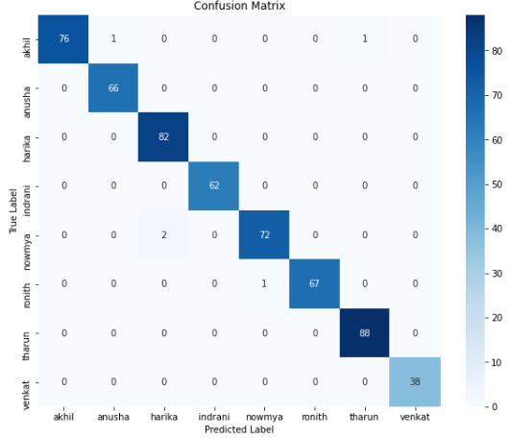
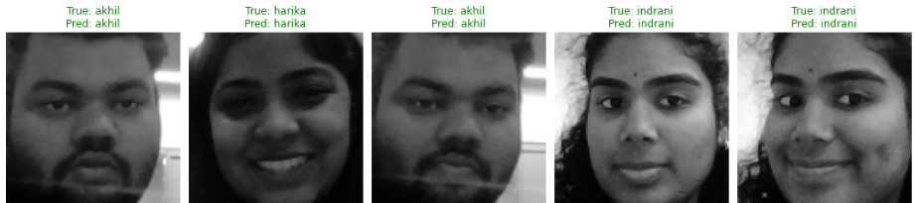
Visualization of Results
Real-time processing includes identifying individual faces and assigning corresponding emotions simultaneously, leveraging both models.
Confusion Matrix
Rows represent the actual (true) classes of the test samples.
Columns represent the predicted classes.
Diagonal Entries: Correct predictions for each emotion and remaining are Misclassified samples

Slide 12
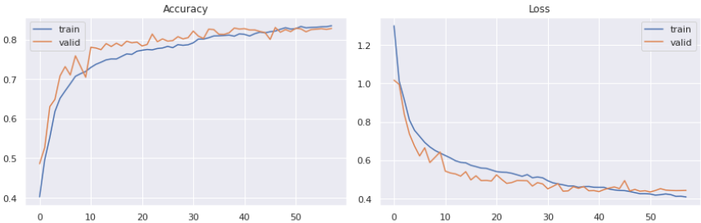
Visualizations for Emotion Recognition model
Accuracy Over Epochs:
Training Accuracy rises consistently
Validation Accuracy follows a similar upward trajectory, closely matching training accuracy.
Loss Over Epochs:
Training Loss shows a steady decrease
Validation Loss initially drops significantly and later stabilizes.
Notes:
Training curves showed consistent improvement in both accuracy and loss, reflecting a well-tuned model architecture

Slide 13
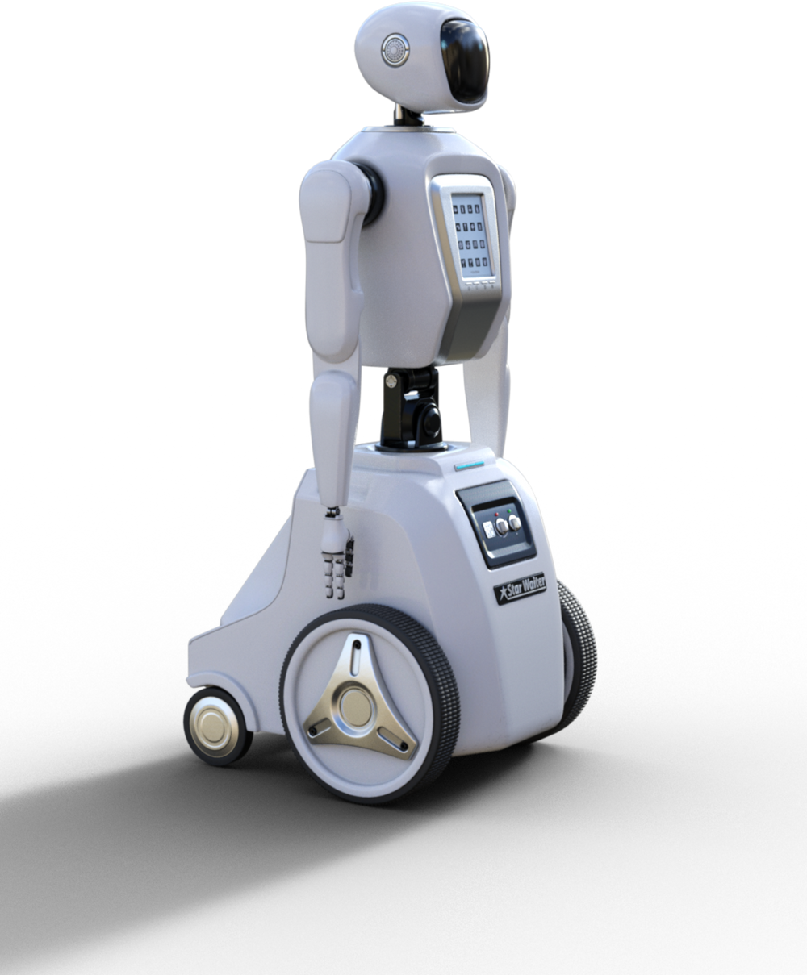
Real-Time Application
Key Features:
Integrated two models for seamless performance.
Live webcam input for instant identification and emotion analysis.
Use Cases:
Smart Classrooms: Track student engagement.
Retail Analytics: Understand customer moods.
Healthcare: Monitor emotional well-being.

Slide 14
Challenges and Insights
Challenges:
Emotion dataset required extensive preprocessing to adapt to our model.
Managing variability in lighting, angles, and facial expressions in real-time scenarios.
Insights:
Data augmentation and dynamic learning rates significantly boosted performance.

Slide 15
Summary and Future Work
Achievements:
Successfully implemented a real-time, dual-function recognition system.
By using different datasets, the system became more flexible and accurate.
Future Directions:
Expand datasets to include diverse demographics.
Explore multi-model inputs like speech or gestures

Slide 16
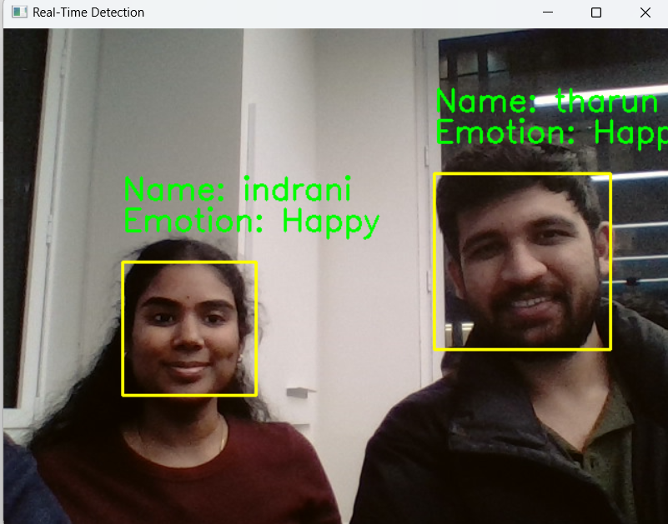
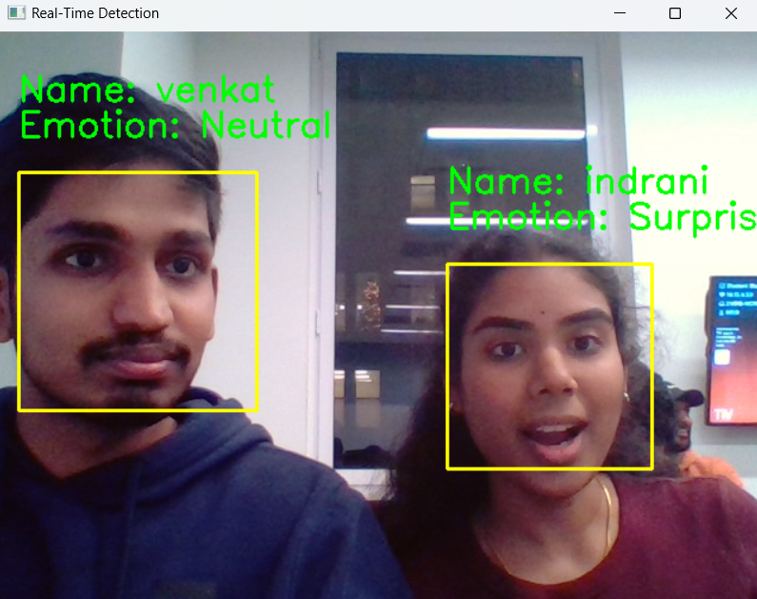
Results
Conclusion:
We seamlessly integrated face recognition and emotion classification into a real-time system.

Slide 17
Thank You!

